Slide 1
IFT 598 Data Visualisation and Reporting for IT
Team members:
Taha Hasan Ahmed
Evan Sequeira
Saaransh Rana
Neeraj Patel
Instructor - Dr. Asmaa Elbadrawy

Slide 2
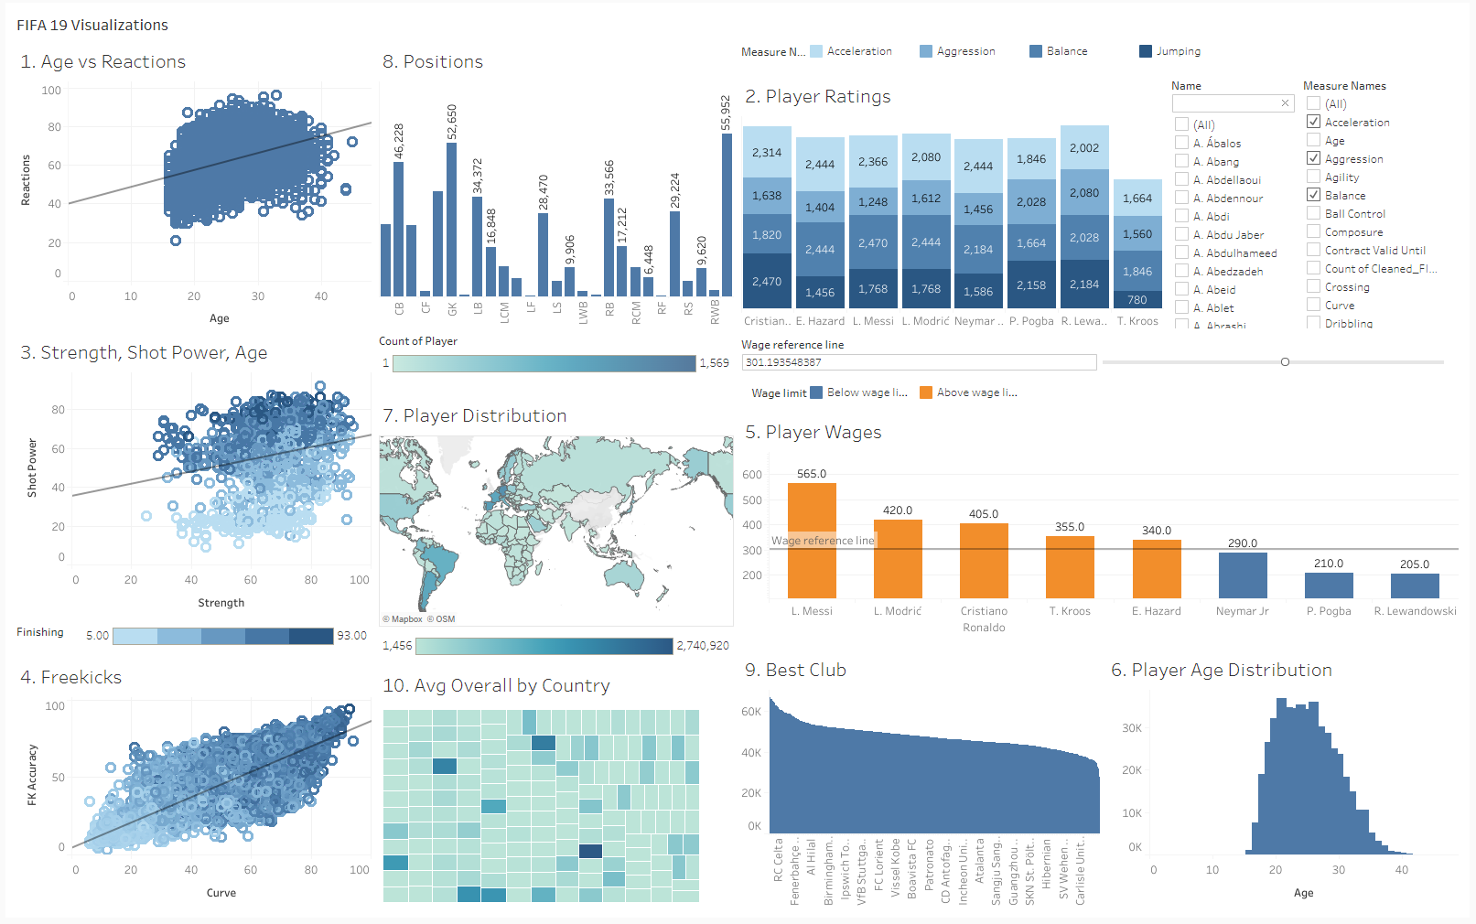
Fifa 19 Dataset Visualization The dashboard visualizes answers to 10 questions relevant to the FIFA 19 dataset. Scatter plots, bar graphs, a choropleth map and a tree map are used. Each plot is shown with the relevant filter and scale. Data-ink ratio has been maximized accordingly.
Section 1: The Dashboard

Slide 3
This dataset contains detailed statistical information for every player registered in the latest edition of FIFA 19.
This is accurate detailed information taken from licensed FIFA player data.
Pre-processing
Null values were dropped.
String were stripped of characters such as the ‘€’, ‘M’ from columns like ‘Value’, ‘Wage’.
‘Height’ and ‘Weight’ column values were stripped.
Columns containing ‘89+2’ were stripped of the additional digits.
Section 2: The Dataset
Attribute Type | Count
Interval | 6
Categorical | 11
Ratio | 70
Ordinal | 2

Slide 4
The prospective users for this dashboard:
People participating in Fantasy League Football
FIFA 19 players
Bookies, or people that facilitate betting on football matches and their results
Football coaches can use this dataset for training metrics
The players themselves to measure and observe their metrics
Talent scouts looking for new players to join their team
Football analysts observing football trends over a large period of time
Can be used by new and veteran football viewers.
Section 3: Dashboard Users

Slide 5
Does a correlation exist between a player’s age and reaction time?
What is each player’s rating in each of the physical statistics (shooting, agility, composure, et cetera)?
For every player, is there a relation between their strength, shot power and finishing, given their age?
Is a player able to score more freekicks based on his accuracy and the curve he can apply on the ball?
Which players are paid the most/least?
What is the age distribution of the players?
What is the player distribution over the world?
Which are the most/least played positions?
Which club has the best overall rating, based on the players?
Do players from certain nations have better ratings than others?
Section 4: Questions

Slide 6
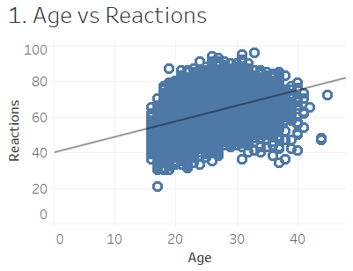
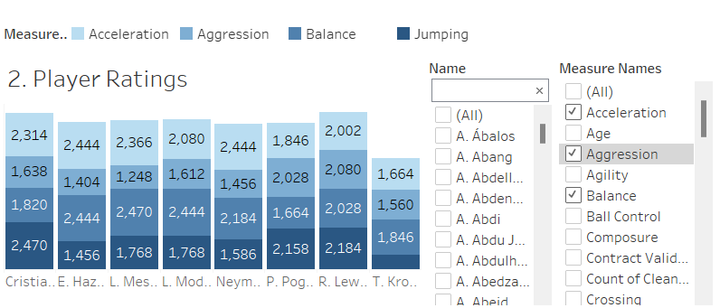
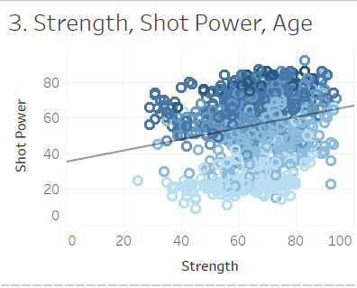
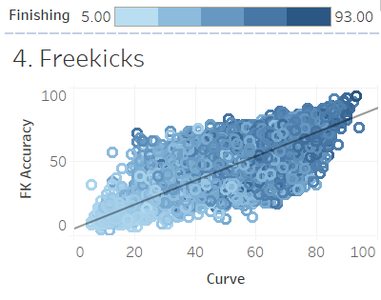
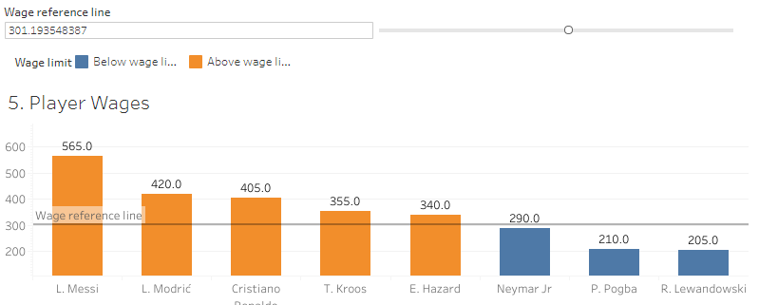
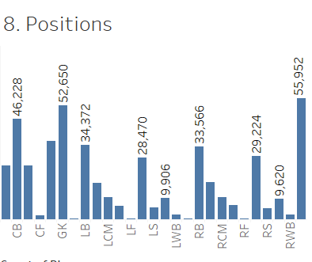
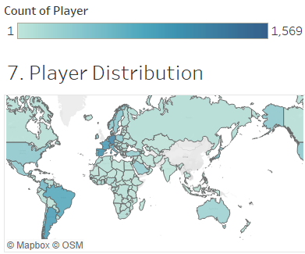
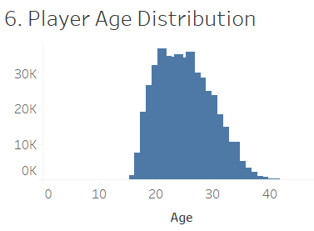
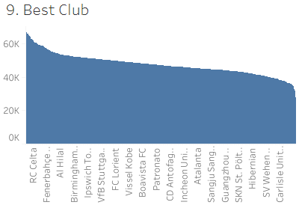
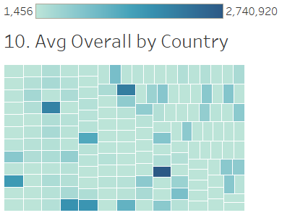
Section 5: Plots

Slide 7
Section 6: Interactivity
Measure Values Filter:
Used to select which of the player’s attributes to be visualized. Connected Plots:
The plot for ‘What is each player’s rating in each of the physical statistics (shooting, agility, composure, et cetera)’.
Value range: 0 – 100.
Name Filter:
Used to select the player for whom attributes will be visualized.
Connected Plots:
The plot for ‘What is each player’s rating in each of the physical statistics (shooting, agility, composure, et cetera)’.
Also, the plot for ‘Player Wages’
Values: List of all the names of the players. (Single select list). Loaded from Names.
Top N Filter:
Used to select Top N players to be displayed in the visualization.
Connected Plots: The plot for ‘Top N Best Player for each position on the field’
Value range : 1 - 10,000
Wage Reference Line:
Used to select wages for players above and below the threshold and shows distinguishing colors.
Connected Plots: The plot for ‘Player Wages’
Value range : 1 - 565

